Slide 1
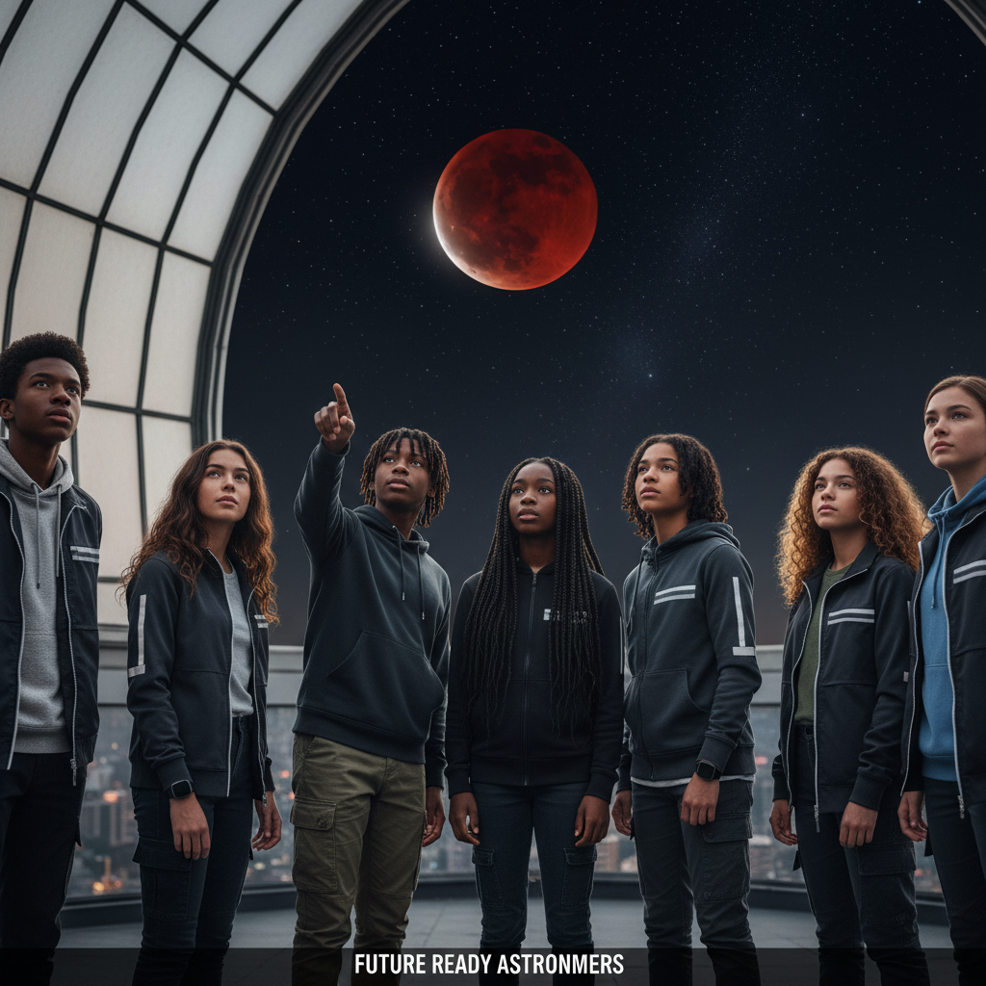
ModelIt!
Student Lesson
Blood Moon: When the Sky Turns Red
The Cosmic Dance of Earth, Moon, and Sun
NGSS: MS-ESS1-1, MS-ESS1-2
7th Grade
1/9

Slide 2
What You Will Learn Today
Learning Goals
* Model how the Moon's orbital position determines the phase we see from Earth
* Explain why lunar eclipses turn the Moon red instead of making it disappear
* Predict when eclipses occur based on the alignment of Earth, Moon, and Sun
* Describe how gravity keeps the Earth-Moon-Sun system in constant motion
Key Vocabulary
Lunar Eclipse
When Earth passes between the Sun and Moon, casting its shadow on the Moon's surface
Orbital Period
The time it takes for one object to complete a full orbit around another — the Moon's is about 29.5 days
Penumbra
The lighter, outer part of a shadow where only some light is blocked
Revolution
One complete orbit of an object around another, like the Moon around Earth
2/9

Slide 3

The Big Question
Why does the Moon change shape every night and sometimes turn blood red?
The Cosmic Dance of Earth, Moon, and Sun. Today we'll build a MODEL to discover the answer!
3/9

Slide 4

Today We Will Build a Model!
A model helps us understand complex systems!
1. LOCATE
Identify the COMPONENTS (parts) of the system
2. ESTABLISH
Connect them with RELATIONSHIPS (+ or -)
3. VISUALIZE
Build your model in ModelIt!
4. EVALUATE
Run SIMULATIONS to test scenarios
5. REVISE
Improve your model based on evidence
4/9

Slide 5

Activity 1: Sort the Components
Sort these components into EXTERNAL (inputs from outside) and INTERNAL (inside the system):
Your Components:
* Sun Angle
* Moon Position
* Earth's Shadow
* Visible Moon Phase
Think: Which components can we control? Which happen on their own?
5/9

Slide 6
Activity 2: Connect with Arrows
Draw arrows to show HOW components affect each other:
(+) POSITIVE Relationship
When one goes UP, the other goes UP too
(-) NEGATIVE Relationship
When one goes UP, the other goes DOWN
Think About It:
When the Moon's position moves directly behind Earth (relative to the Sun), what happens to Earth's shadow and the visible Moon phase?
6/9

Slide 7
Activity 3: Run the Simulation!
Test these scenarios in ModelIt!
Full Moon Night
Set Moon Position to opposite side of Earth from Sun and observe
Lunar Eclipse
Align Moon Position directly behind Earth's shadow and observe
New Moon
Set Moon Position between Earth and Sun and observe visibility
Watch the activity graphs change!
[ModelIt Platform Screenshot - Simulation Results Graph]
7/9

Slide 8
What Did We Discover?
Our Model Showed Us:
* The Moon doesn't produce its own light — it reflects sunlight, so its appearance depends on position
* Lunar eclipses turn the Moon red because Earth's atmosphere bends red light into the shadow
* Eclipses don't happen every month because the Moon's orbit is tilted 5 degrees relative to Earth's
* Gravity is the invisible force that keeps the Moon orbiting Earth and Earth orbiting the Sun
Answer: The Moon appears to change shape because we see different amounts of its sunlit side as it orbits Earth. During a lunar eclipse, Earth blocks direct sunlight but our atmosphere bends red wavelengths into the shadow — painting the Moon blood red!
8/9

Slide 9

STEM Challenge: Design a Moon Phase Predictor
YOUR ENGINEERING MISSION
Design a physical or digital tool that can predict the Moon's phase and eclipse events for any date, using your understanding of orbital mechanics.
The Challenge:
A local planetarium needs a hands-on exhibit that helps visitors understand why the Moon changes shape and when the next eclipse will occur. Your team has been hired to build the prototype.
Think Like an Engineer:
* How can you represent the Moon's orbit to accurately show phases?
* What determines whether a full moon is a normal full moon or an eclipse?
* How would your predictor account for the Moon's tilted orbit?
REAL CAREER CONNECTION: Planetary Scientists and Astronomers study celestial mechanics and predict eclipses, tides, and orbital events. They work at NASA, observatories, and universities, earning $70,000–$130,000/year. The skills you're using TODAY are the same ones they use on the job!
9/9

